Slide 1
SOLID Introduction
SOLID principles are the design principles that enable us manage most of the software design problems
The term SOLID is an acronym for five design principles intended to make software designs more understandable, flexible and maintainable
The principles are a subset of many principles promoted by Robert C. Martin
The SOLID acronym was first introduced by Michael Feather
SOLID Acronym
S : Single Responsibility Principle (SRP)
O : Open closed Principle (OSP)
L : Liskov substitution Principle (LSP)
I : Interface Segregation Principle (ISP)
D : Dependency Inversion Principle (DIP)

Slide 2
Single Responsibility Principle
Robert C. Martin expresses the principle as, "A class should have only one reason to change”
Every module or class should have responsibility over a single part of the functionality provided by the software, and that responsibility should be entirely encapsulated by the class
Open/Closed Principle
“Software entities should be open for extension, but closed for modification”
The design and writing of the code should be done in a way that new functionality should be added with minimum changes in the existing code
The design should be done in a way to allow the adding of new functionality as new classes, keeping as much as possible existing code unchanged
Liskov Substitution Principle
Introduced by Barbara Liskov state that “objects in a program should be replaceable with instances of their sub-types without altering the correctness of that program”
If a program module is using a Base class, then the reference to the Base class can be replaced with a Derived class without affecting the functionality of the program module
We can also state that Derived types must be substitutable for their base types
Interface Segregation Principle
“Many client-specific interfaces are better than one general-purpose interface”
We should not enforce clients to implement interfaces that they don't use. Instead of creating one big interface we can break down it to smaller interfaces
Dependency Inversion Principle
One should “depend upon abstractions, [not] concretions"
Abstractions should not depend on the details whereas the details should depend on abstractions
High-level modules should not depend on low level modules

Slide 3
If we don’t follow SOLID Principles
we End up with tight or strong coupling of the code with many other modules/applications
Tight coupling causes time to implement any new requirement, features or any bug fixes and some times it creates unknown issues
End up with a code which is not testable
End up with duplication of code
End up creating new bugs by fixing another bug
End up with many unknown issues in the application development cycle
Following SOLID Principles helps us to
Achieve reduction in complexity of code
Increase readability, extensibility and maintenance
Reduce error and implement Reusability
Achieve Better testability
Reduce tight coupling
Solution to develop a successful application depends on
Architecture : choosing an architecture is the first step in designing application based on the requirements. Example : MVC, WEBAPI, MVVM..etc
Design Principles : Application development process need to follow the design principles
Design Patterns : We need to choose correct design patterns to build the software

Slide 4
Single Responsibility Principle in C#
What is the Single Responsibility Principle in C#?
How can we achieve the Single Responsibility Principle in C#?
Example without using the Single Responsibility Principle.
Problems of not following the SRP.
Example using the SRP.
The letter S in SOLID stands for the Single Responsibility Principle which is also known as SRP. As part of this article, we are going to discuss the following pointers in detail.
What is the Single Responsibility Principle in C#?
The Single Responsibility Principle states that “Each software module or class should have only one reason to change“. In other words, we can say that each module or class should have only one responsibility to do.
So we need to design the software in such a way that everything in a class or module should be related to a single responsibility. That does not mean your class should contain only one method or property, you can have multiple members (methods or properties) as long as they are related to a single responsibility or functionality. So, with the help of SRP, the classes become smaller and cleaner and thus easier to maintain.
How can we achieve the Single Responsibility Principle in C#?
Let us understand the need for the Single Responsibility Principle in C# with an example. Suppose we need to design an Invoice class. As we know an Invoice class basically used to calculate various amounts based on its data. The Invoice class does not know how to retrieve the data, or how to format the data for display, print, logging, or sending an email, etc.
If we write the database logic, business logic as well as display logic in a single class, then our class performing multiple responsibilities. Then it becomes very difficult to change one responsibility without breaking the other responsibilities. So, by mixing multiple responsibilities into a single class, we are getting the following disadvantage,
Difficult to understand
Difficult to test
Chance of duplicating the logic of other parts of the application

Slide 5
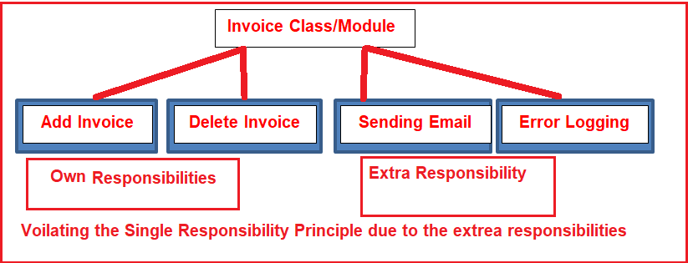
Example of without the Single Responsibility Principle in C#:
As you can see in the above image, we are going to create an Invoice class with four functionalities as Adding and Deleting Invoices, Error Logging as well as Sending Emails. As we are putting all the above four functionalities into a single class or module, we are violating the Single Responsibility Principle. This is because Sending Email and Error Logging are not a part of the Invoice module

Slide 6
namespace SOLID_PRINCIPLES.SRP
{
public class Invoice
{
public long InvAmount { get; set; }
public DateTime InvDate { get; set; }
public void AddInvoice()
{
try
{
// Here we need to write the Code for adding invoice
// Once the Invoice has been added, then send the mail
MailMessage mailMessage = new MailMessage("EMailFrom", "EMailTo", "EMailSubject", "EMailBody");
this.SendInvoiceEmail(mailMessage);
}
catch (Exception ex)
{ System.IO.File.WriteAllText(@"c:\ErrorLog.txt", ex.ToString());
}
}
public void DeleteInvoice()
{
try
{ //Here we need to write the Code for Deleting the already generated invoice
}
catch (Exception ex)
{ System.IO.File.WriteAllText(@"c:\ErrorLog.txt", ex.ToString());
}
}
public void SendInvoiceEmail(MailMessage mailMessage)
{
try
{ // Here we need to write the Code for Email setting and sending the invoice mail
}
catch (Exception ex)
{ System.IO.File.WriteAllText(@"c:\ErrorLog.txt", ex.ToString());
}
}
}
}

Slide 7
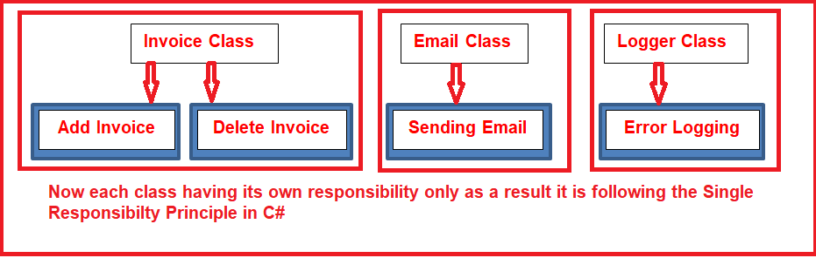
Example: Implementing the SRP in C#

Slide 8
using System;
namespace SRP_SOlid
{
public interface ILogger
{
void Info(string info);
void Debug(string info);
void Error(string message, Exception ex);
}
public class Logger : ILogger
{
public Logger()
{
// here we need to write the Code for initialization
// that is Creating the Log file with necesssary details
}
public void Info(string info)
{
// here we need to write the Code for info information into the ErrorLog text file
}
public void Debug(string info)
{
// here we need to write the Code for Debug information into the ErrorLog text file
}
public void Error(string message, Exception ex)
{
// here we need to write the Code for Error information into the ErrorLog text file
}
}
}
namespace SRP_SOlid
{
public class MailSender
{
public string EMailFrom { get; set; }
public string EMailTo { get; set; }
public string EMailSubject { get; set; }
public string EMailBody { get; set; }
public void SendEmail()
{
// Here we need to write the Code for sending the mail
}
}
}

Slide 9
using System;
namespace SRP_SOlid
{ public class Invoice
{ public long InvAmount { get; set; }
public DateTime InvDate { get; set; }
private ILogger fileLogger;
private MailSender emailSender;
public Invoice()
{
fileLogger = new Logger();
emailSender = new MailSender();
}
public void AddInvoice()
{
try
{ fileLogger.Info("Add method Start");
// Here we need to write the Code for adding invoice
// Once the Invoice has been added, then send the mail
emailSender.EMailFrom = "emailfrom@xyz.com";
emailSender.EMailTo = "emailto@xyz.com";
emailSender.EMailSubject = "Single Responsibility Princile";
emailSender.EMailBody = "A class should have only one reason to change";
emailSender.SendEmail();
}
catch (Exception ex)
{ fileLogger.Error("Error Occurred while Generating Invoice",ex );
}
}
public void DeleteInvoice()
{
try
{
//Here we need to write the Code for Deleting the already generated invoice
fileLogger.Info("Delete Invoice Start at @" + DateTime.Now);
}
catch (Exception ex)
{
fileLogger.Error("Error Occurred while Deleting Invoice", ex);
}
}
}
}
}
As you can see, the Invoice class delegating the logging activity to the “Logger” class. In the same way, delegate the Email Sending activity to the “MailSender” class. Now, the Invoice class now only concentrates on Invoice related activities.

Slide 10
The letter O in SOLID stands for the Open-Closed Principle which is also known as OCP.
What is the Open-Closed Principle in C#?
Implementation Guidelines for the Open-Closed Principle in C#
What Problems you will get if you are not following the Open-Closed Principle?
Example without using the Open-Closed Principle.
Example using the Open-Closed Principle in C#.
What is the Open-Closed Principle in C#?
The Open-Closed Principle states that “software entities such as modules, classes, functions, etc. should be open for extension, but closed for modification“.
Let us understand the above definition in simple words. Here we need to understand two things. The first thing is Open for extension and the second thing is Closed for modification. The Open for extension means we need to design the software modules/classes in such a way that the new responsibilities or functionalities should be added easily when new requirements come. On the other hand, Closed for modification means, we should not modify the class/module until we find some bugs.
The reason for this is, we have already developed a class/module and it has gone through the unit testing phase. So we should not have to change this as it affects the existing functionalities. In simple words, we can say that we should develop an entity in such a way that it should allow its behavior to be extended without altering its source code.
Implementation Guidelines for the Open-Closed Principle in C#
The easiest way to implement the Open-Closed Principle in C# is to add the new functionalities by creating new derived classes which should be inherited from the original base class.
Another way is to allow the client to access the original class with an abstract interface.
So, at any given point of time when there is a change in requirement or any new requirement comes then instead of touching the existing functionality, it’s always better and suggested to create new derived classes and leave the original class implementation as it is.
Problems of Not following the Open-Closed Principle in C#:
If you are not following the Open-Closed Principle during the application development process, then you may end up your application development with the following problems
If you allow a class or function to add new logic then as a developer you need to test the entire functionalities which include the old functionalities as well as new functionalities of the application.
As a developer, it is also your responsibility to tell the QA (Quality Assurance) team about the changes in advance so that they can prepare themselves in advance for regression testing along with the new feature testing.
If you are not following the Open-Closed Principle, then it also breaks the Single Responsibility Principle as the class or module is going to perform multiple responsibilities.
If you are implementing all the functionalities in a single class, then the maintenance of the class becomes very difficult.
Because of the above key points, we need to follow the open-closed principle in C# while developing the application.

Slide 11
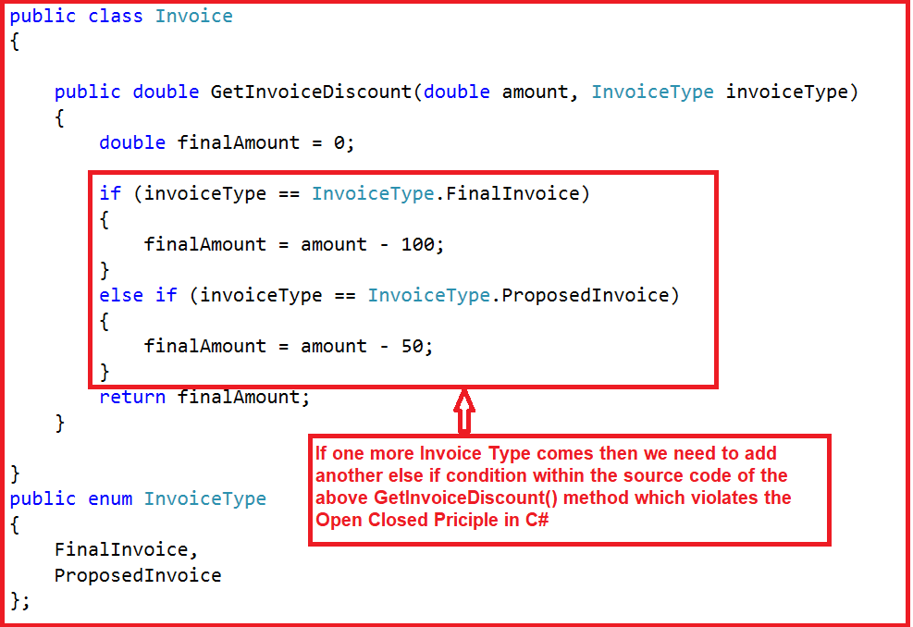
Let us understand the Open-Closed Principle in C# with one example
As you can see in the above image, within the Invoice class we have created the GetInvoiceDiscount() method. As part of that GetInvoiceDiscount() method, we are calculating the final amount based on the Invoice type. As of now, we have two Invoice Types as the Final Invoice and Proposed Invoice. So we have implemented the logic using if-else. Tomorrow, if one more Invoice Type comes into the picture then we need to modify the GetInvoiceDiscount() method logic by adding another else if block to the source code. As we are changing the source code for the new requirement, we are violating the Open-Closed principle in C#.

Slide 12
using System;
namespace SOLID_PRINCIPLES.OCP
{
public class Invoice
{
public double GetInvoiceDiscount(double amount, InvoiceType invoiceType)
{
double finalAmount = 0;
if (invoiceType == InvoiceType.FinalInvoice)
{ finalAmount = amount - 100;
}
else if (invoiceType == InvoiceType.ProposedInvoice)
{ finalAmount = amount - 50;
}
return finalAmount;
}
}
public enum InvoiceType
{ FinalInvoice,
ProposedInvoice
};
}
The problem with the above example is that if we want to add another new invoice type, then we need to add one more “if” condition in the same “GetInvoiceDiscount” method, in other words, we need to modify the Invoice class. If we are changing the Invoice class again and again then we need to ensure that the previous functionalities along with the new functionalities are working properly by testing both the functionalities again. This is because we need to ensure that the existing clients, which are referencing this class are working properly as expected or not.

Slide 13
As per the Open-Closed principle, Instead of “MODIFYING”, we should go for “EXTENSION”.
If you want to follow the Open-Closed Principle in the above example, when a new invoice type needs to be added, then we need to add a new class. As a result, the current functionalities that are already implemented are going to be unchanged. The advantage is that we just only need to test and check the new classes.
namespace SOLID_PRINCIPLES.OCP
{
public class Invoice
{
public virtual double GetInvoiceDiscount(double amount)
{
return amount - 10;
}
}
public class FinalInvoice : Invoice
{
public override double GetInvoiceDiscount(double amount)
{
return base.GetInvoiceDiscount(amount) - 50;
}
}
public class ProposedInvoice : Invoice
{
public override double GetInvoiceDiscount(double amount)
{
return base.GetInvoiceDiscount(amount) - 40;
}
}
public class RecurringInvoice : Invoice
{
public override double GetInvoiceDiscount(double amount)
{
return base.GetInvoiceDiscount(amount) - 30;
}
}
}
using System;
namespace SOLID_PRINCIPLES.OCP
{
class Program
{
static void Main(string[] args)
{
Invoice FInvoice = new FinalInvoice();
Invoice PInvoice = new ProposedInvoice();
Invoice RInvoice = new RecurringInvoice();
double FInvoiceAmount = FInvoice.GetInvoiceDiscount(1000);
double PInvoiceAmount = PInvoice.GetInvoiceDiscount(1000);
double RInvoiceAmount = RInvoice.GetInvoiceDiscount(1000);
Console.ReadKey();
}
}
}
Now, the Invoice class is closed for modification. But it is open for the extension as it allows creating new classes deriving from the Invoice class which clearly follows the Open-Closed Principle in C#.

Slide 14
The Letter L in SOLID stands for Liskov Substitution Principle which is also known as LSP.
namespace SOLID_PRINCIPLES.LSP
{
class Program
{
static void Main(string[] args)
{
Apple apple1 = new Apple();
Console.WriteLine(apple.GetColor());
Apple apple = new Orange();
Console.WriteLine(apple.GetColor());
}
}
public class Apple
{
public virtual string GetColor()
{
return "Red";
}
}
public class Orange : Apple
{
public override string GetColor()
{
return "Orange";
}
}
}
What is the Liskov Substitution Principle?
The Liskov Substitution Principle is a Substitutability principle in object-oriented programming Language. This principle states that, if S is a subtype of T, then objects of type T should be replaced with the objects of type S. In other words, we can say that objects in an application should be replaceable with the instances of their subtypes without modifying the correctness of that application.
For example, a father is a teacher whereas his son is a doctor. So here, in this case, the son can’t simply replace his father even though both belong to the same family.
Example without using the Liskov Substitution Principle in C#:
Let us first understand one example without using the Liskov Substitution Principle in C#. In the following example, first, we create the Apple class with the method GetColor. Then we create the Orange class which inherits the Apple class as well as overrides the GetColor method of the Apple class. The point is that an Orange cannot be replaced by an Apple, which results in printing the color of the apple as Orange as shown in the below example.
namespace SOLID_PRINCIPLES.LSP
{
class Program
{
static void Main(string[] args)
{
Fruit fruit = new Orange();
Console.WriteLine(fruit.GetColor());
fruit = new Apple();
Console.WriteLine(fruit.GetColor());
}
}
public abstract class Fruit
{
public abstract string GetColor();
}
public class Apple : Fruit
{
public override string GetColor()
{
return "Red";
}
}
Example Using the Liskov Substitution Principle in C#
Let’s modify the previous example to follow the Liskov Substitution Principle. Here, first, we need a generic base class such as Fruit for both Apple and Orange. Now you can replace the Fruit class object with its subtypes either Apple and Orage and it will behave correctly.
public class Orange : Fruit
{
public override string GetColor()
{
return "Orange";
}
}
}
Now, run the application and it should give the output as expected. Here we are following the LSP as we are now able to change the object with its subtype.

Slide 15
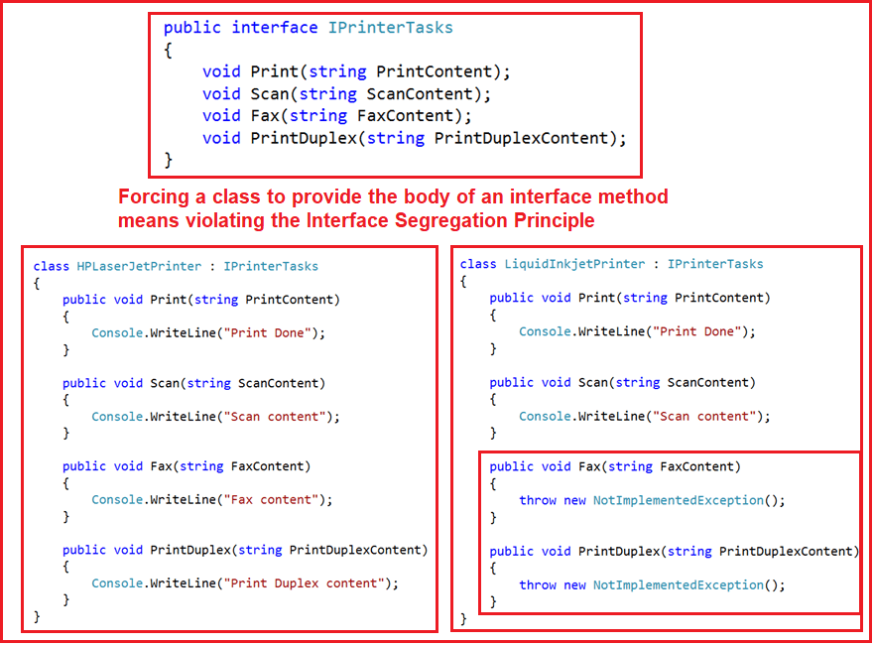
What is the Interface Segregation Principle in C#?
The Interface Segregation Principle states that “Clients should not be forced to implement any methods they don’t use. Rather than one fat interface, numerous little interfaces are preferred based on groups of methods with each interface serving one submodule“.
Let us break down the above definition into two parts.
First, no class should be forced to implement any method(s) of an interface they don’t use.
Secondly, instead of creating large or you can say fat interfaces, create multiple smaller interfaces with the aim that the clients should only think about the methods that are of interest to them.
As per the Single Responsibility Principle of SOLID, like classes, interfaces also should have a single responsibility. That means we shouldn’t force any class to implement any method(s) which they don’t require.

Slide 16
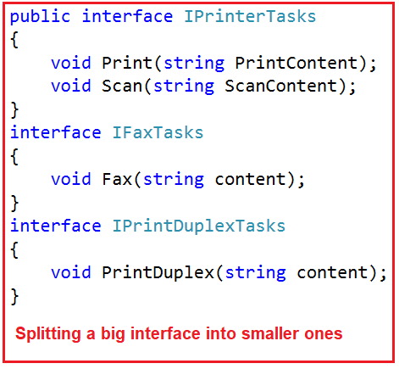
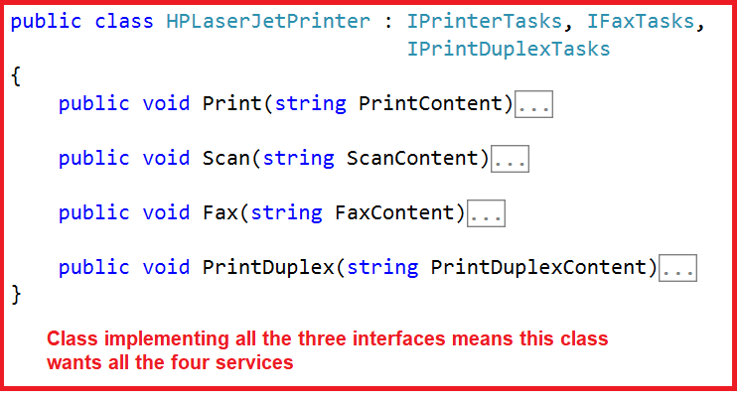
As you can see in the above diagram, we have an interface i.e. IPrinterTasks declared with four methods. Now if any class wants to implement this interface then that class should have to provide the implementation to all the four methods of the IPrinterTasks interface. As you can see in the above diagram, we have two classes HPLaserJetPrinter and LiquidInkjetPrinter who want the printer service.
But the requirement is the HPLaserJetPrinter wants all the services provided by the IPrinterTasks while the LiquidInkjetPrinter wants only the Print and Scan service of the printer. As we have declared all the methods within the IPrinterTasks interface, then it is mandatory for the LiquidInkjetPrinter class to provide implementation to Scan and Print methods along with the Fax and PrinctDulex method which are not required by the class.
Example using the Interface Segregation Principle:

Slide 17

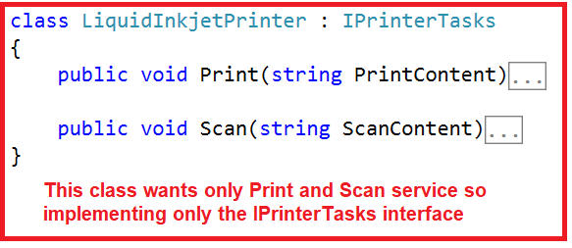
As you can see in the above diagram, now we have split that big interface into three small interfaces.
Each interface now having some specific purpose. Now if any class wants all the services then that class needs to implement all the three interfaces as shown below.
Now, if any class wants the Scan and Print service, then that class needs to implement only the IPrinterTasks interfaces as shown in the below image.

Slide 18
Example without using the Interface Segregation Principle in C#:
namespace SOLID_PRINCIPLES.ISP
{
public class HPLaserJetPrinter : IPrinterTasks
{
public void Print(string PrintContent)
{
Console.WriteLine("Print Done");
}
public void Scan(string ScanContent)
{
Console.WriteLine("Scan content");
}
public void Fax(string FaxContent)
{
Console.WriteLine("Fax content");
}
public void PrintDuplex(string PrintDuplexContent)
{
Console.WriteLine("Print Duplex content");
}
}
}
namespace SOLID_PRINCIPLES.ISP
{
public interface IPrinterTasks
{
void Print(string PrintContent);
void Scan(string ScanContent);
void Fax(string FaxContent);
void PrintDuplex(string PrintDuplexContent);
}
}
namespace SOLID_PRINCIPLES.ISP
{
class LiquidInkjetPrinter : IPrinterTasks
{
public void Print(string PrintContent)
{
Console.WriteLine("Print Done");
}
public void Scan(string ScanContent)
{
Console.WriteLine("Scan content");
}
public void Fax(string FaxContent)
{
throw new NotImplementedException();
}
public void PrintDuplex(string PrintDuplexContent)
{
throw new NotImplementedException();
}
}
}
As you can see in the above LiquidInkjetPrinter class the Fax and PrintDuplex methods are not required by the class but, still, it is implementing these two methods. This is violating the Interface Segregation Principle in C# as we are forcing the class to implement two methods that they don’t require.

Slide 19
Example using the Interface Segregation Principle:
namespace SOLID_PRINCIPLES.ISP
{
public interface IPrinterTasks
{
void Print(string PrintContent);
void Scan(string ScanContent);
}
interface IFaxTasks
{
void Fax(string content);
}
interface IPrintDuplexTasks
{
void PrintDuplex(string content);
}
}
namespace SOLID_PRINCIPLES.ISP
{
public class HPLaserJetPrinter : IPrinterTasks, IFaxTasks,
IPrintDuplexTasks
{
public void Print(string PrintContent)
{
Console.WriteLine("Print Done");
}
public void Scan(string ScanContent)
{
Console.WriteLine("Scan content");
}
public void Fax(string FaxContent)
{
Console.WriteLine("Fax content");
}
public void PrintDuplex(string PrintDuplexContent)
{
Console.WriteLine("Print Duplex content");
}
}
}
namespace SOLID_PRINCIPLES.ISP
{
class LiquidInkjetPrinter : IPrinterTasks
{
public void Print(string PrintContent)
{
Console.WriteLine("Print Done");
}
public void Scan(string ScanContent)
{
Console.WriteLine("Scan content");
}
}
}

Slide 20
The Dependency Inversion Principle (DIP) states that high-level modules/classes should not depend on low-level modules/classes. Both should depend upon abstractions.
Secondly, abstractions should not depend upon details. Details should depend upon abstractions.
The most important point that you need to remember while developing real-time applications, always to try to keep the High-level module and Low-level module as loosely coupled as possible.
When a class knows about the design and implementation of another class, it raises the risk that if we do any changes to one class will break the other class. So we must keep these high-level and low-level modules/classes loosely coupled as much as possible. To do that, we need to make both of them dependent on abstractions instead of knowing each other.

Slide 21
namespace SOLID_PRINCIPLES.DIP
{
public class Employee
{
public int ID { get; set; }
public string Name { get; set; }
public string Department { get; set; }
public int Salary { get; set; }
}
}
namespace SOLID_PRINCIPLES.DIP
{
public class EmployeeBusinessLogic
{
EmployeeDataAccess _EmployeeDataAccess;
public EmployeeBusinessLogic()
{
_EmployeeDataAccess = DataAccessFactory.GetEmployeeDataAccessObj();
}
public Employee GetEmployeeDetails(int id)
{
return _EmployeeDataAccess.GetEmployeeDetails(id);
}
}
}
namespace SOLID_PRINCIPLES.DIP
{
public class DataAccessFactory
{
public static EmployeeDataAccess GetEmployeeDataAccessObj()
{
return new EmployeeDataAccess();
}
}
}
namespace SOLID_PRINCIPLES.DIP
{
public class EmployeeDataAccess
{
public Employee GetEmployeeDetails(int id)
{
// In real time get the employee details from db
//but here we are hard coded the employee details
Employee emp = new Employee()
{
ID = id,
Name = "Pranaya",
Department = "IT",
Salary = 10000
};
return emp;
}
}
}
Let us compare the above example with the Dependency Inversion Principle in C#
As per the Dependency Inversion Principle definition, “a high-level module should not depend on low-level modules. Both should depend on the abstraction”.

Slide 22
As per the Dependency Inversion Principle definition, “a high-level module should not depend on low-level modules. Both should depend on the abstraction”.
So, first, we need to figure out which one is the high-level module (class) and which one is the low-level module (class) in our example. A high-level module is a module that always depends on other modules. So, in our example, the EmployeeBusinessLogic class depends on EmployeeDataAccess class, so here the EmployeeBusinessLogic class is the high-level module and the EmployeeDataAccess class is the low-level module.
So, as per the first rule of the Dependency Inversion Principle in C#, the EmployeeBusinessLogic class/module should not depend on the concrete EmployeeDataAccess class/module, instead, both the classes should depend on abstraction.
The second rule of the Dependency Inversion Principle state that “Abstractions should not depend on details. Details should depend on abstractions”.

Slide 23
What is Abstraction?
In simple words, we can say that Abstraction means something which is non-concrete. So, abstraction in programming means we need to create either an interface or abstract class which is non-concrete so that we can not create an instance of it. In our example, the EmployeeBusinessLogic and EmployeeDataAccess are concrete classes that mean we can create objects of it.
As per the Dependency Inversion Principle in C#, the EmployeeBusinessLogic (high-level module) should not depend on the concrete EmployeeDataAccess (low-level module) class. Both classes should depend on abstractions, meaning both classes should depend on either an interface or an abstract class.
What should be in the interface (or in the abstract class)?
As you can see in the above example, the EmployeeBusinessLogic uses the GetEmployeeDetails() method of EmployeeDataAccess class. In real-time, there will be many employee-related methods in the EmployeeDataAccess class. So, we need to declare the GetEmployeeDetails(int id) method within the interface. Add one interface with the name IDataAccess and then copy and paste the following codes.

Slide 24
Now, we need to change the EmployeeBusinessLogic class which will use the IEmployeeDataAccess instead of the concrete EmployeeDataAccess class as shown below.
namespace SOLID_PRINCIPLES.DIP
{
public interface IEmployeeDataAccess
{
Employee GetEmployeeDetails(int id);
}
}
Now, we need to change the factory class which will return the IEmployeeDataAccess instead of the concrete EmployeeDataAccess class as shown below.
DataAccessFactory.cs
namespace SOLID_PRINCIPLES.DIP
{
public class EmployeeBusinessLogic
{
IEmployeeDataAccess _EmployeeDataAccess;
public EmployeeBusinessLogic()
{
_EmployeeDataAccess = DataAccessFactory.GetEmployeeDataAccessObj();
}
public Employee GetEmployeeDetails(int id)
{
return _EmployeeDataAccess.GetEmployeeDetails(id);
}
}
}
Now, we need to implement the IEmployeeDataAccess in EmployeeDataAccess class. So, modify the EmployeeDataAccess class as shown below
namespace SOLID_PRINCIPLES.DIP
{
public class DataAccessFactory
{
public static IEmployeeDataAccess GetEmployeeDataAccessObj()
{
return new EmployeeDataAccess();
}
}
}
namespace SOLID_PRINCIPLES.DIP
{
public class EmployeeDataAccess : IEmployeeDataAccess
{
public Employee GetEmployeeDetails(int id)
{
// In real time get the employee details from db
//but here we are hardcoded the employee details
Employee emp = new Employee()
{
ID = id,
Name = "Pranaya",
Department = "IT",
Salary = 10000
};
return emp;
}
}
}
public static IEmployeeDataAccess GetEmployeeDataAccessObj()
EmployeeDataAccess
_EmployeeDataAccess
public interface IEmployeeDataAccess
ID = id,
Name = "Pranaya",
Department = "IT",
Salary = 10000
Employee GetEmployeeDetails(int id);
emp

Slide 25
That’s it. We have implemented the Dependency Inversion Principle in our example where the high-level module (EmployeeBusinessLogic) and low-level module (EmployeeDataAccess) depend on abstraction (IEmployeeDataAccess). Also, abstraction (IEmployeeDataAccess) does not depend on details (EmployeeDataAccess) but details depend on abstraction.
Advantages of implementing the Dependency Inversion Principle in C#:
Now, the EmployeeBusinessLogic and EmployeeDataAccess classes are loosely coupled classes because EmployeeBusinessLogic does not depend on concrete EmployeeDataAccess class, instead, it includes a reference of IEmployeeDataAccess interface. So now, we can easily use another class that implements IEmployeeDataAccess with a different implementation.

